Slide 1


eventee
The Five Engineers

Slide 2
Product Vision
“To provide conference attendees with an automatic, personalized schedule to reduce time spent preparing for the conference.”

Slide 3
Why eventee?
Have you ever been to a conference only to find yourself running from one workshop to another and having to leave in the middle of the most interesting part just so you could see a little bit of another one? Or even failed to enter a workshop because the session was full? Then, eventee is the app for you. List your favorite workshops and it will give you a schedule without having to deal with partial sessions or full rooms.

Slide 4
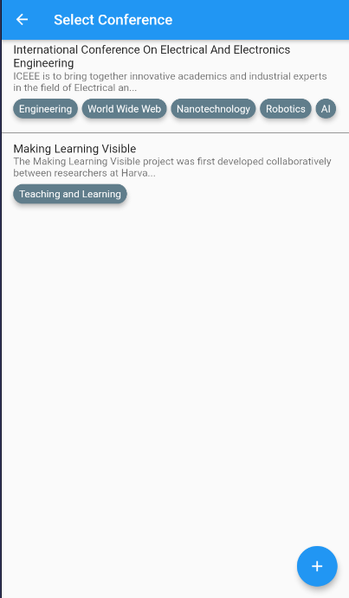
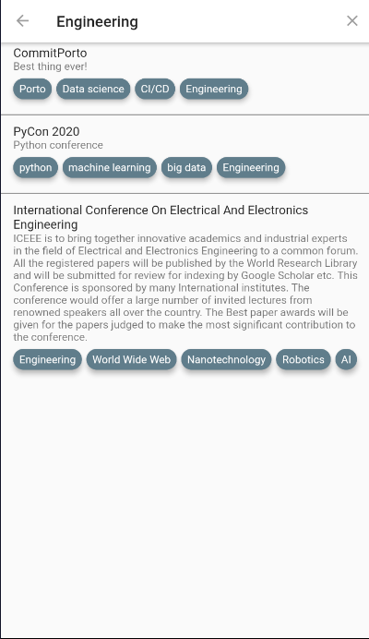
You can select/create a conference to organize…
VS
Or choose a conference to attend…

Slide 5
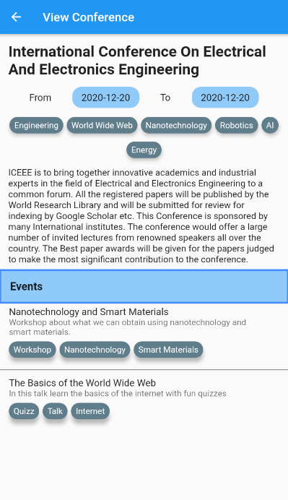
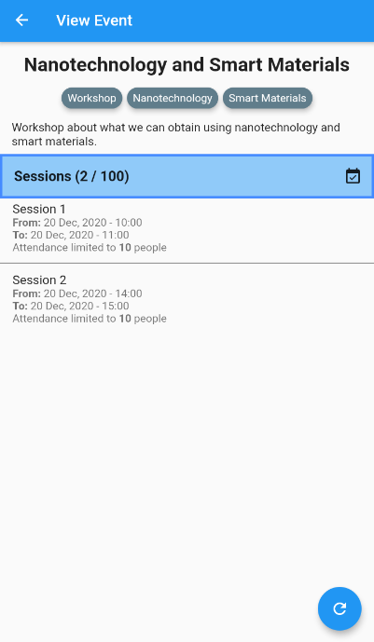
You can view conferences…
Or even view it’s talks/workshops…

Slide 6

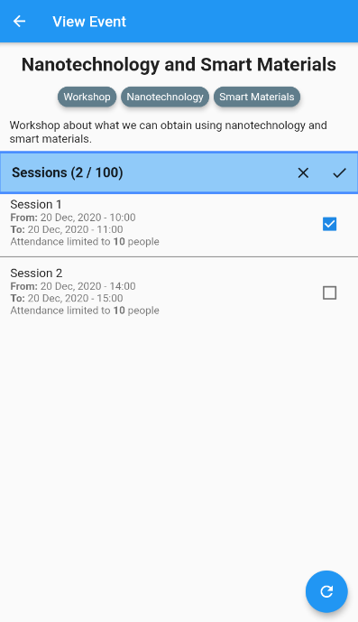
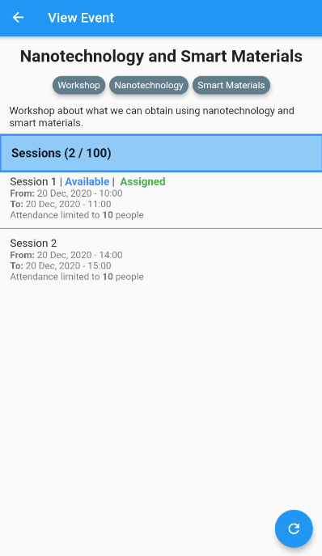
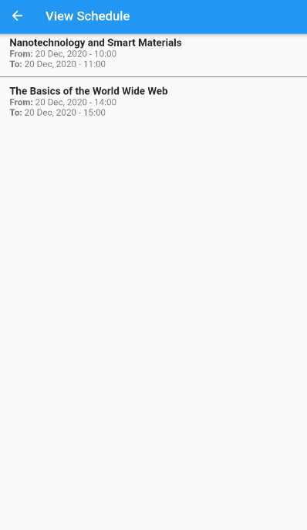
And if you want to save some time organizing your schedule…
Use eventee to make it a lot easier!

